Slide 1
Atari Game with Zap Q-Learning
RL Final Project-Group 6
Group Member: XUANZHAO DONG, XUYIN ZHU, MUCHEN LI(sick leave)
Notes:
Presenter: Shiker

Slide 2
Structure
Zap Q-learning
Simulation over Cartpole problem
Atari Game
Future Work

Slide 3
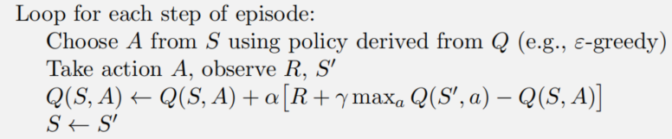
Motivation
Q-Learning
Adithya M.Devraj and Sean P.Meyn Fastest Convergence for Q-Learning,2018

Slide 4
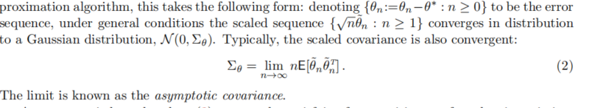
Is It great?
Central Limit Theorem (CLT)
Asymptotic covariance
cause of death for men, women in the United States
of adults in the United States have heart failure
659K
die in the United States every year from heart disease
380K
death certificates mentioned heart disease, in 2018
805K
people have heart attacks in the United States, every year
$30.7B
in costs to the United States related to heart failure
Adithya M.Devraj and Sean P.Meyn Fastest Convergence for Q-Learning,2018
Notes:
Presenter: Joseph
Sepsis is a big problem, but overtreating is also a big problem, bc down the line u get antibiotic resistance stuff

Slide 5
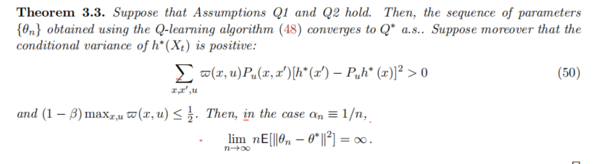
Is It great?
Adithya M.Devraj and Sean P.Meyn Fastest Convergence for Q-Learning,2018

Slide 6
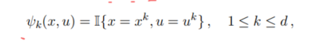
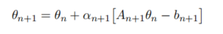
Can we improve the result?
Linear SA: Q-learning
Adithya M.Devraj and Sean P.Meyn Fastest Convergence for Q-Learning,2018

Slide 7
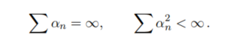
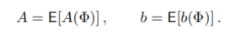
Optimal covariance
Adithya M.Devraj and Sean P.Meyn Fastest Convergence for Q-Learning,2018

Slide 8
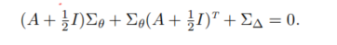
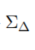
How to get asymptotic covariance
Lyapunov Equation
How to get ?
Adithya M.Devraj and Sean P.Meyn Fastest Convergence for Q-Learning,2018

Slide 9
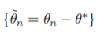
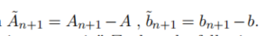
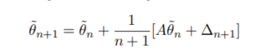
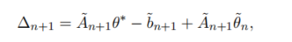
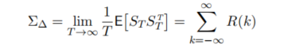
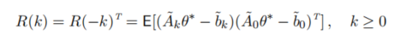
Calculate noise covariance matrix
Adithya M.Devraj and Sean P.Meyn Fastest Convergence for Q-Learning,2018

Slide 10
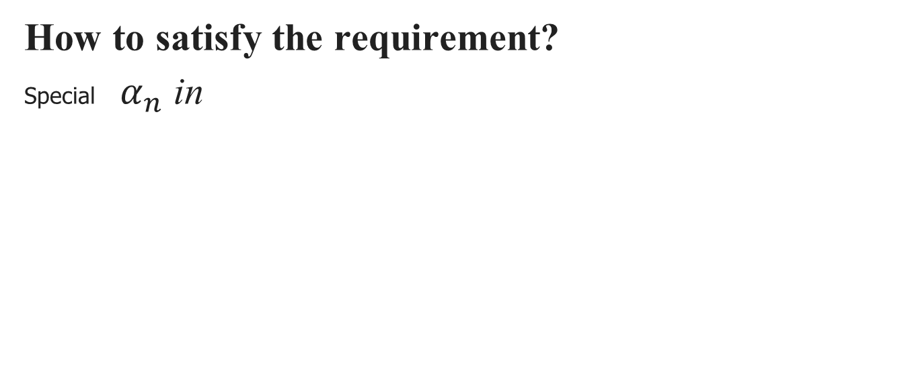
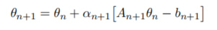
Limitation
A solution is guaranteed only if each eigenvalue of A has real part that is strictly less than -1/2
Adithya M.Devraj and Sean P.Meyn Fastest Convergence for Q-Learning,2018

Slide 11

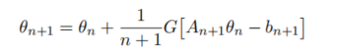
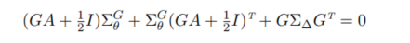
Matrix gain
Choosing to use Matrix G rather than scalar g:
Adithya M.Devraj and Sean P.Meyn Fastest Convergence for Q-Learning,2018

Slide 12
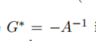
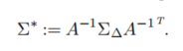
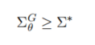
Optimal matrix choice
Optimal matrix:
Adithya M.Devraj and Sean P.Meyn Fastest Convergence for Q-Learning,2018

Slide 13
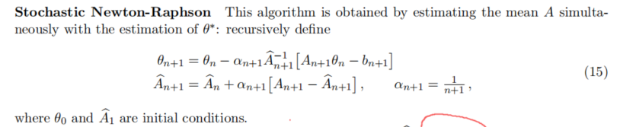
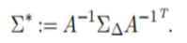
Stochastic Newton-Raphson
Adithya M.Devraj and Sean P.Meyn Fastest Convergence for Q-Learning,2018

Slide 14
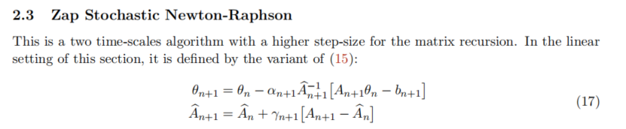
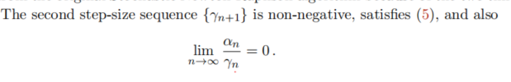
Zap Stochastic Newton-Raphson
Adithya M.Devraj and Sean P.Meyn Fastest Convergence for Q-Learning,2018

Slide 15
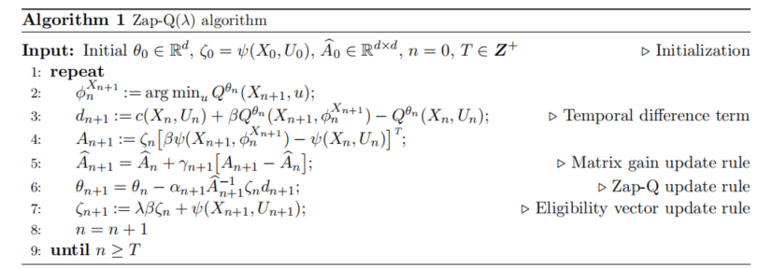
Zap Q-learning
Adithya M.Devraj and Sean P.Meyn Fastest Convergence for Q-Learning,2018

Slide 16
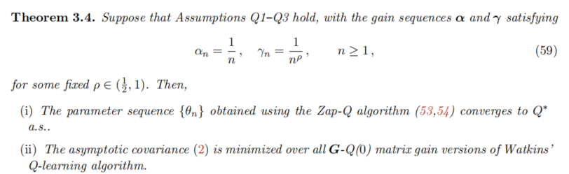
Zap Q-learning
Adithya M.Devraj and Sean P.Meyn Fastest Convergence for Q-Learning,2018

Slide 17
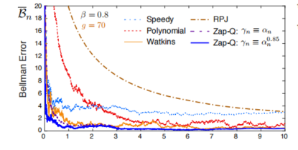
Zap Q-learning
Adithya M.Devraj and Sean P.Meyn Fastest Convergence for Q-Learning,2018

Slide 18
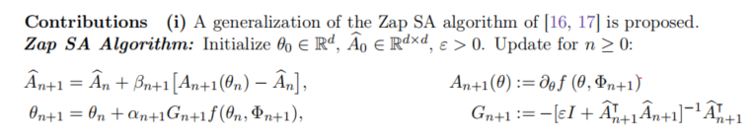
Generalization of Zap Q-learning
Shuhuang Chen, Adithya M.Devarj, Fan Lu, Ana Busic and Sean Meyn. Zap Q-learning with Nonlinear Function Approximation,2020

Slide 19
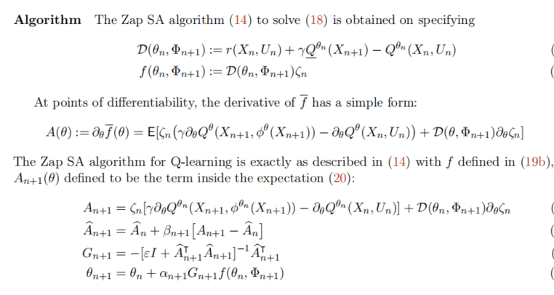
Generalization of Zap Q-learning
Shuhuang Chen, Adithya M.Devarj, Fan Lu, Ana Busic and Sean Meyn. Zap Q-learning with Nonlinear Function Approximation,2020

Slide 20
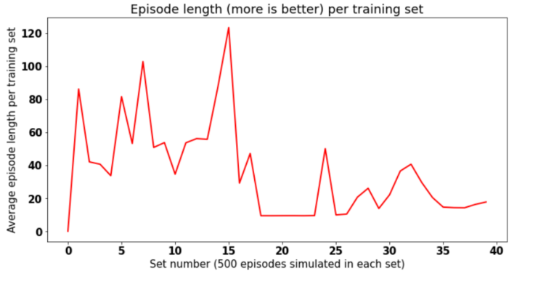
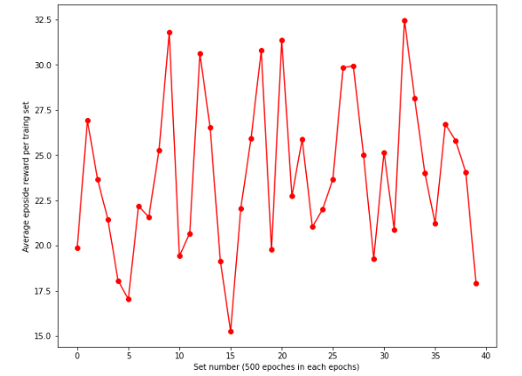
Simulation over Cartpole problem
Zap Q-Learning
Deep Q-Learning

Slide 21
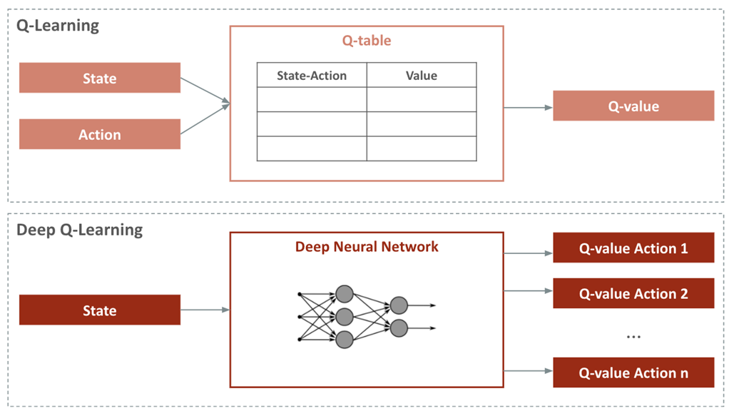
Deep Q-Learning
•Network architecture
•fully-connected layers, with ReLU
•convolutional layers + fully-connected layers, with ReLU
•Experience replay
•store the agent’s experiences at each time-step, et = (st,at,rt,st+1)
in a data-set D = e1,...,eN.
•During Q-learning update, sample a minibatch of experience,
e ∼ D, from the pool of stored samples D.
•Online_net and target_net
https://medium.com/@parsa_h_m/deep-reinforcement-learning-dqn-double-dqn-dueling-dqn-noisy-dqn-and-dqn-with-prioritized-551f621a9823
Notes:
let me go over some important concepts about DQN because we use it as the baseline model. For high dimensional state space, such as video games, it is impractical to apply Q learning. Rather, it is common to approximate the action value function. Neural network can be used as a function approximator.
We used two kinds of architecture: simple games use just fully connected layers, and complicated games use convolutional + fully connected layers.
(如果没有时间说下面的部分，就说：for implementation, we use experience replay and 2 q-networks. I am going to skip the details they are in the lab6 already)
we implemented experience replay buffer to eliminate strong correlations between samples and reduce the variance of the updates.
for better training result, online net is updated every epoch and target net is the copy of the online net. We use target net to attain the Q value.

Slide 22
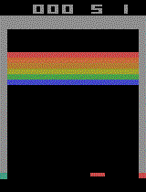
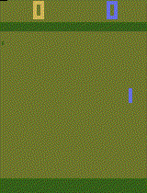
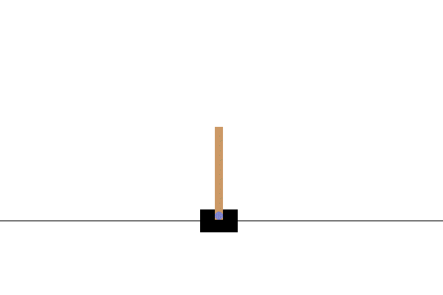
Test environment introduction
Gym
Atari
Breakout
Pong
M. G. Bellemare, Y. Naddaf, J. Veness and M. Bowling. The Arcade Learning Environment: An Evaluation Platform for General Agents, Journal of Artificial Intelligence Research, Volume 47, pages 253-279, 2013.

Slide 23
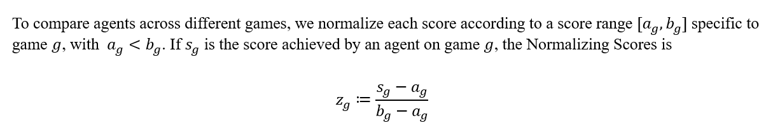
Evaluation Metrics
M. G. Bellemare, Y. Naddaf, J. Veness and M. Bowling. The Arcade Learning Environment: An Evaluation Platform for General Agents, Journal of Artificial Intelligence Research, Volume 47, pages 253-279, 2013.

Slide 24
Future Work
1. Apply Deep Q-learning and Zap Q-Learning to playing planned Atari game, e.g., Breakout and Pong.
2. Compare their performance on different games by using normalizing scores .

Slide 25
Thank You!

